Slide 1









Real-time ESLR

Slide 2





Introduction
We've built a real-time sign language interpreter using computer vision and machine learning. With a webcam and a click, it translates your sign language gestures into text. Let's explore how it works.

Slide 3




Project overview

Slide 4
Available Approaches
Image Classifier
Landmark Detector

Slide 5
Why Landmark Detection ?
Precise Info: Landmark detection tells us exactly where your hand is and how it moves, making it great for understanding sign language.
Detailed Data: It gives us lots of information about hand gestures, like how fingers are positioned and how they move.
Works in Real-Time: Landmark detection can keep up with your hand as it moves, so it's perfect for live sign language translation.
Flexible: It's also good at handling different hand shapes and orientations, which is important for understanding sign language through a webcam.
Dmensionality Reduction: We are reducing the dimentionality of our data by keeping the same information.

Slide 6
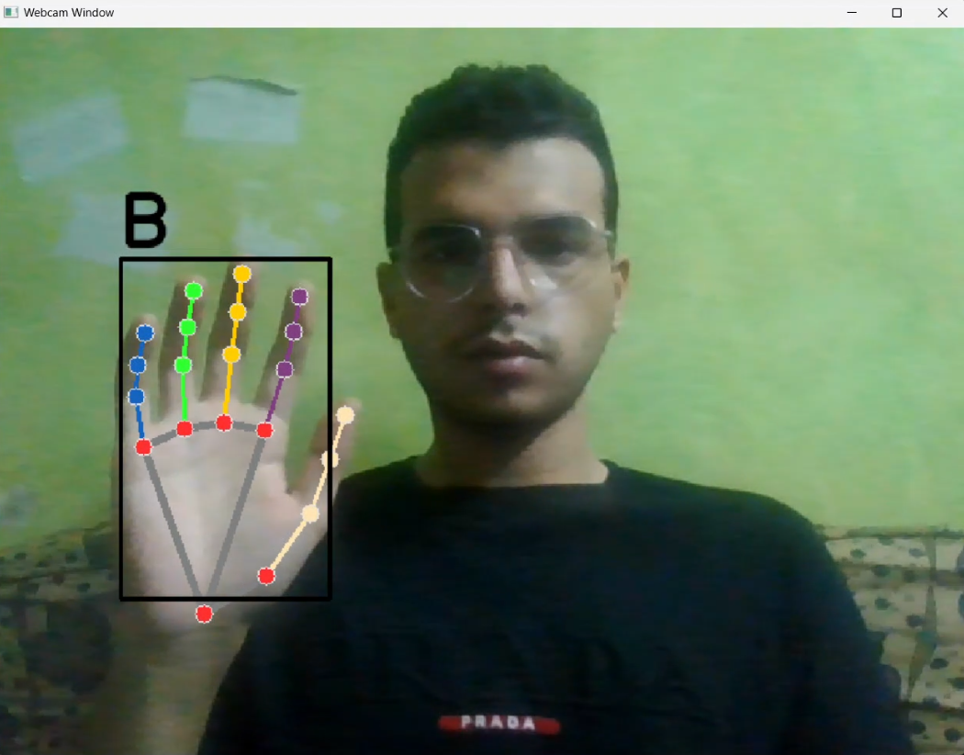

Slide 7
Preprocessing

Slide 8
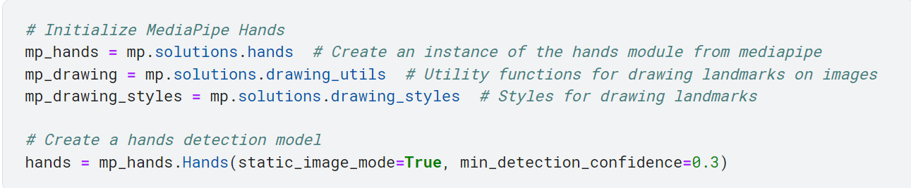
Handling the data

Slide 9
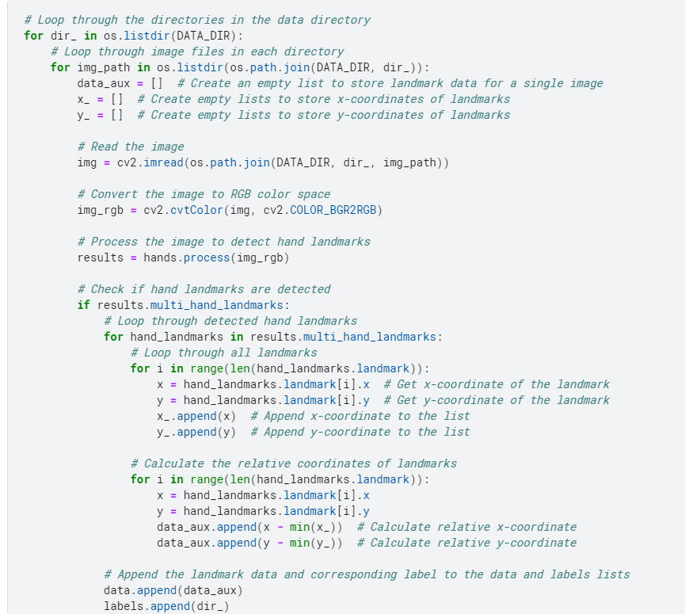

Slide 10
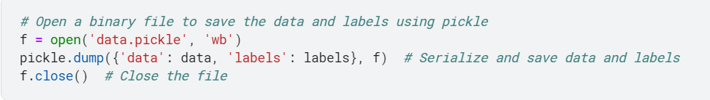
Save the data after handling it to a pickle file

Slide 11
Training the data

Slide 12
Random Forrest model
Why I chose RF not any other model ?
We chose to implement a Random Forest model for this project due to its robust performance in classification tasks, especially in scenarios where there may be a complex relationship between input features and output labels. Random Forests are known for their ability to handle high-dimensional data, which is crucial when dealing with hand landmark information. Additionally, Random Forests provide good generalization capabilities and are less prone to overfitting, making them a suitable choice for our sign language gesture classification task. However, it's important to note that the choice of model can be influenced by various factors, including dataset size, data complexity, and project goals.

Slide 13
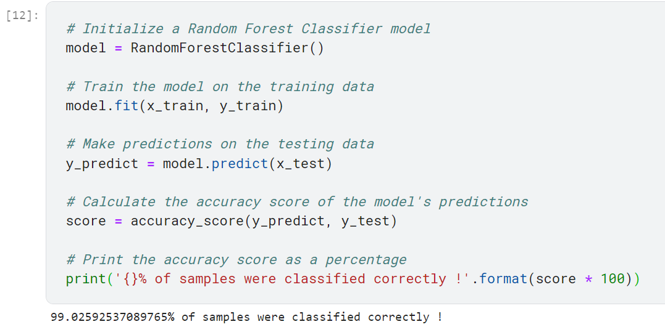
What happened when we chose the RF model ?
We got 99 % test accuracy and thet was amazing I think .

Slide 14
Basic CNN Model
I tried also CNN model, and the test accuracy was 100 % but I chose to make it with the Random Forrest because this 3 reasons :

Slide 15
Basic CNN Model
Generalization: Achieving 100% accuracy on the test set could be an indicator of overfitting, where the CNN model may have memorized the training data rather than learning generalized patterns. The Random Forest, with its 99% accuracy, demonstrates strong generalization, which means it's likely to perform well on new, unseen sign language gestures.
Real-World Variability: Sign language interpretation in real-world scenarios often involves various challenges like lighting changes, hand orientations, and diverse signing styles. The Random Forest model, with its robustness, is better suited to handle these real-world variations.
Interpretability: Random Forest models are more interpretable, making it easier to understand why a specific prediction is made. This transparency is valuable for debugging and fine-tuning the system.

Slide 16
Streamlit application
Now we wil make a web application by using Streamlit and OpenCV
We will make the same preprocessing that we did to the training data to the input data that we take from the user and send this data to our model to predict.
We will do that through live stream by WebCam.

Slide 17
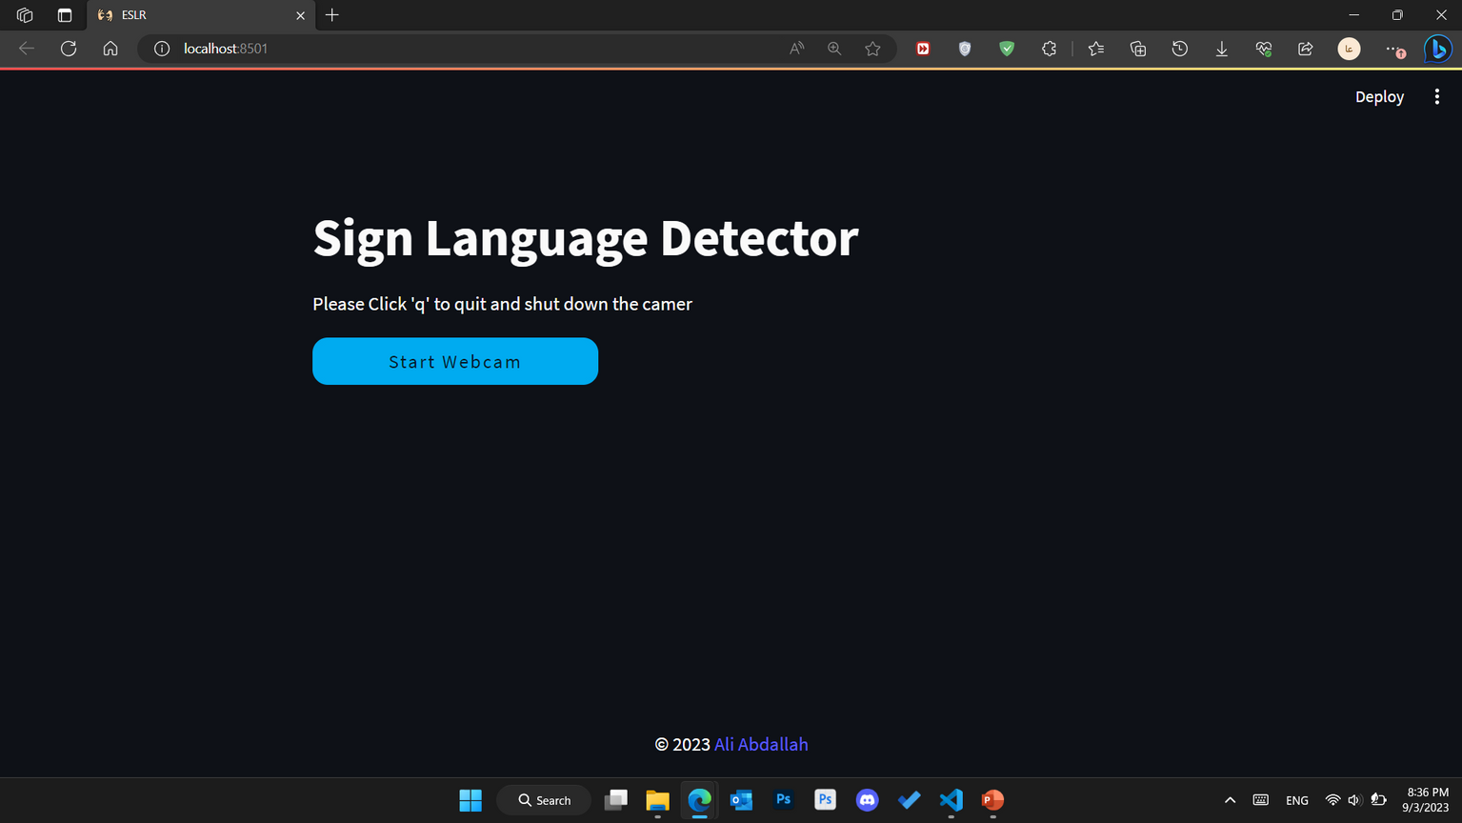
Streamlit application

Slide 18
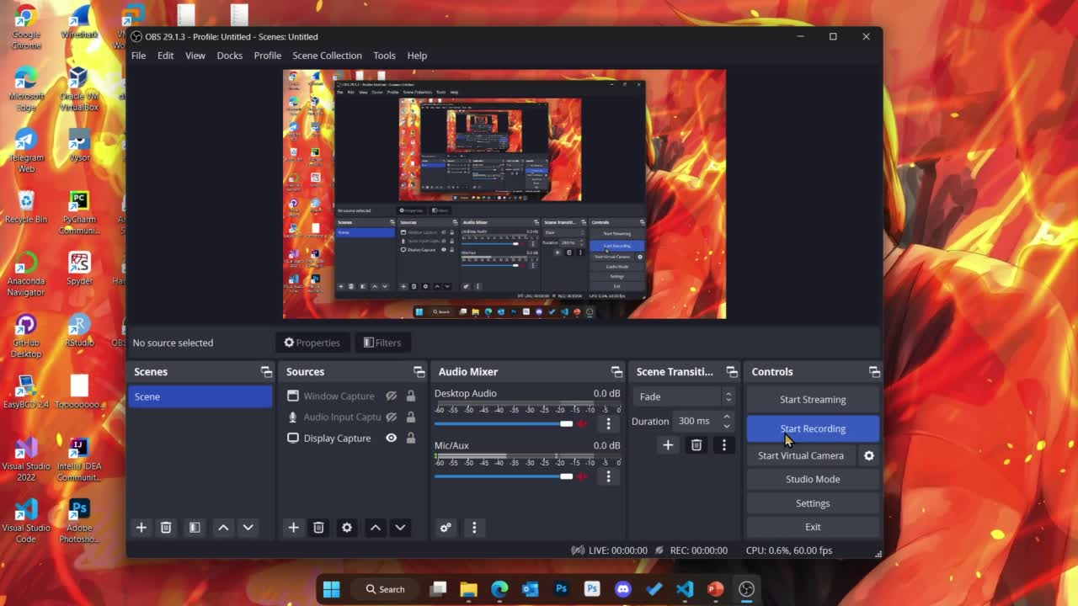
Streamlit application Demo

Slide 19
Thank You

